Slide 1
Understanding the Budget and Levy Lid Lift
September 23, 2025

Slide 2
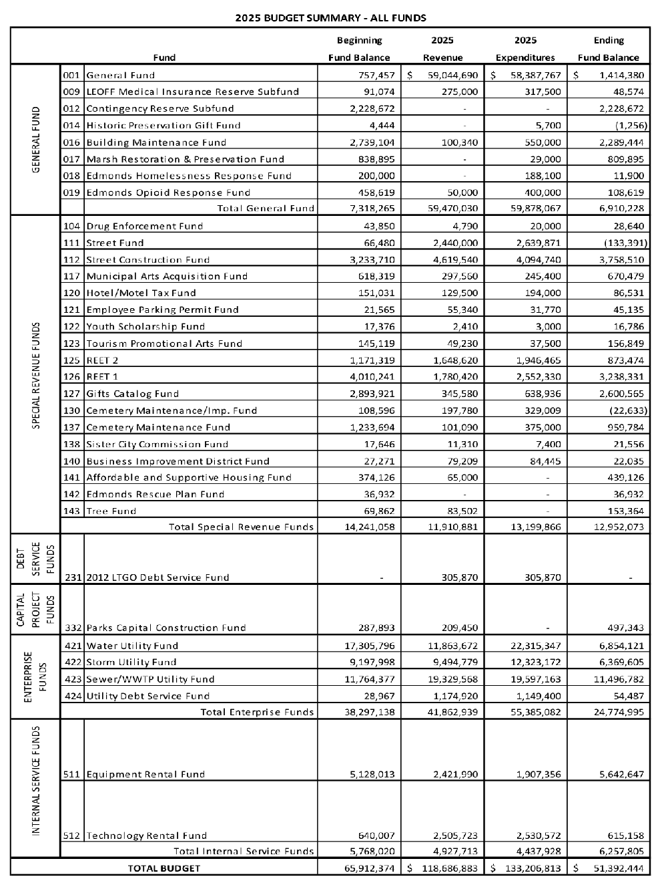
What is “The Budget”?
The city budget is comprised of six primary funds
General Funds
Special Revenue Funds
Debt Service Fund
Capital Projects Fund
Enterprise Funds
Internal Service Funds
There are 34 different accounts within these funds
The mayor proposes a budget – the City Council owns the budget
Once adopted, the mayor executes the budget while the City Council has oversight responsibilities
2025 Adopted Budget

Slide 3
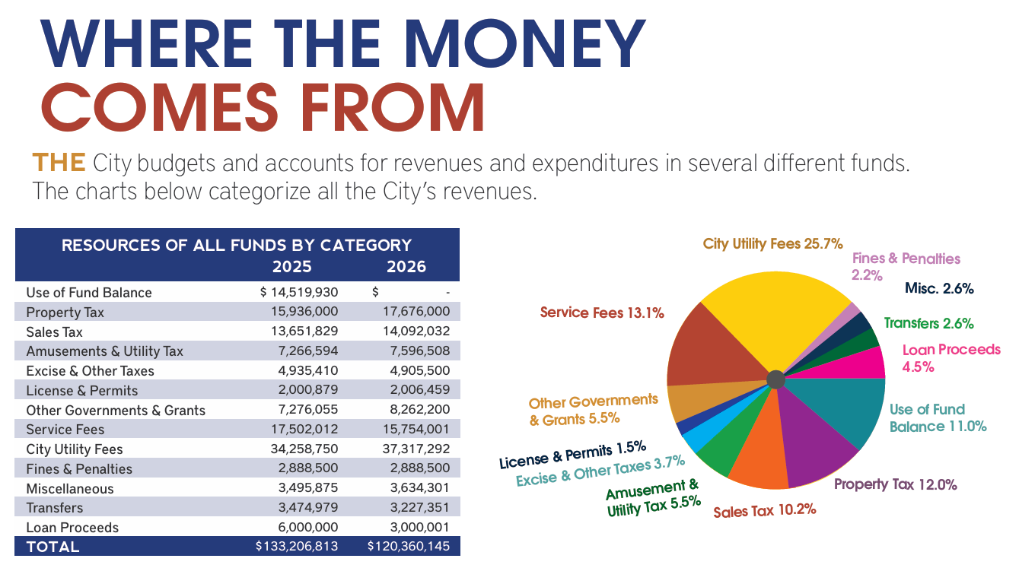

Slide 4
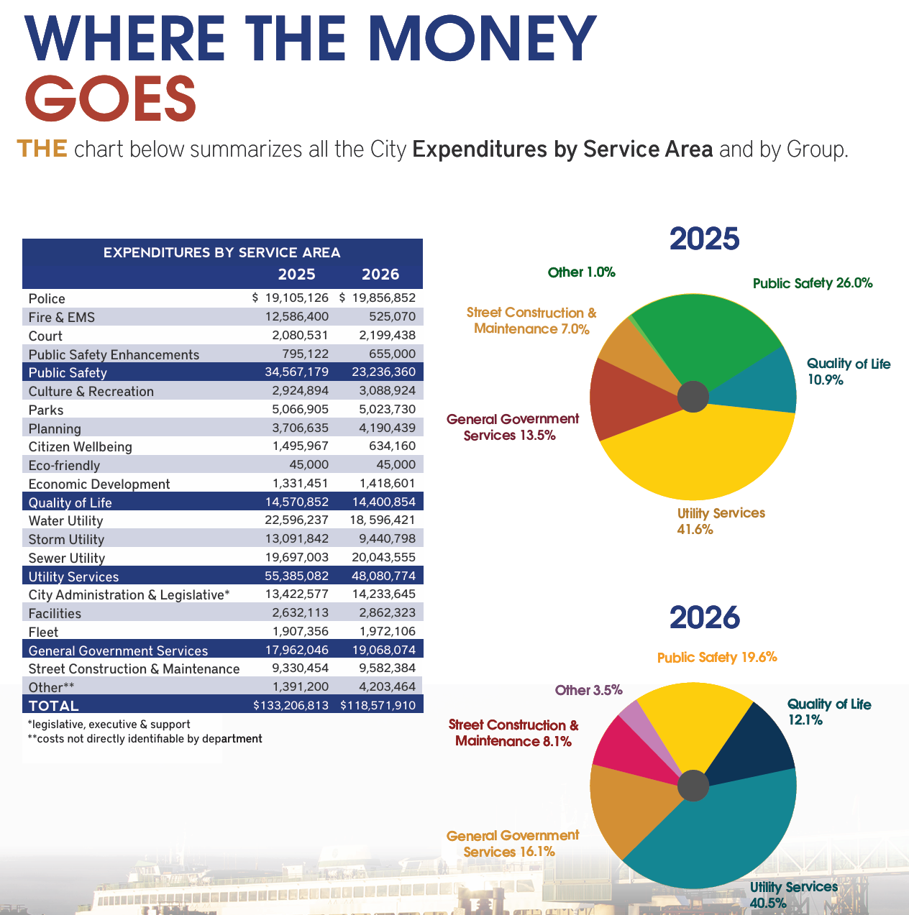

Slide 5
General Fund History
Reserve funds + ARPA + unbanked
($9.2M)
RFA annex. +
$6M Levy Lid Lift
($12.4M)
Interfund Loan
($6.0M)
Single-year, Permanent Levy Lid Lift
($ 6.0M)
Approach used to balance the budget:
Reserve funds
($13.4M)
Adopted
Budgets
Forecast
Unreserved funds
General Fund Balance
Fiscal emergency declared 11/6/23
GF Emergency Reserves (16%)
RFA Annexation
City Council’s adopted budget includes $6M levy lid lift
Contingency Reserves (4%)
Insolvent
2021 2022 2023 2024 2025 2026 2027 2028 2029

Slide 6
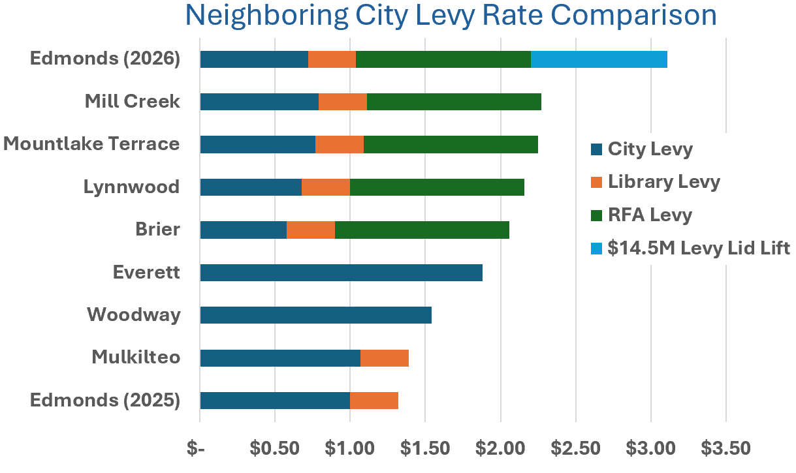
What happens if the $14.5M levy lid lift passes?…
Increases city property tax rate by 126% (from $0.72/$1,000 AV to $1.63)
City keeps $6.5M in fire contract cost savings
An additional $8.5M is distributed to various fund accounts for 2026

Slide 7
What happens if the $14.5M levy lid lift fails?…
City property tax rate would remain at $0.72/$1,000 AV
City keeps $6.5M in fire contract cost savings
A combination of $6M in new revenue or expense reductions is necessary for 2026 to offset the assumed levy lid lift in the budget
The city has defined dramatic “cuts” in services
An alternative budget is proposed which does not require service level reductions while still balancing the budget
The city has also committed to finding $5M in non-property tax revenue

Slide 8
We have Money – Where is it?
Fund | 2025 Expected Ending Fund Balance
General Funds | $7,174,211
Special Revenue Funds | $14,731,712
Debt Service Fund | -
Capital Projects Fund | $538,551
Enterprise Funds | $30,029,792
Internal Service Funds | $6,657,126
Total | $59,131,392

Slide 9
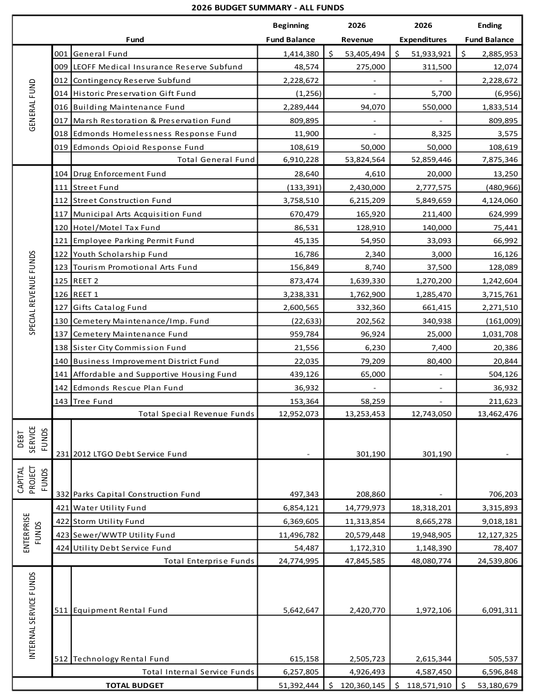
Alternative Budget Proposal
Close the Internal Service Funds (ISF) and transfer all balances, revenues and expenses to the General Fund
The ISFs are not legally required
They contain underutilized fund balances
This represents a legal framework to support the GF
Provides approximately $6.6M to the GF balance
Offsets the $6M in “cuts” if the levy fails
This is not a loan that needs to be paid back
Rational
Transfer into General Fund
End Result

Slide 10
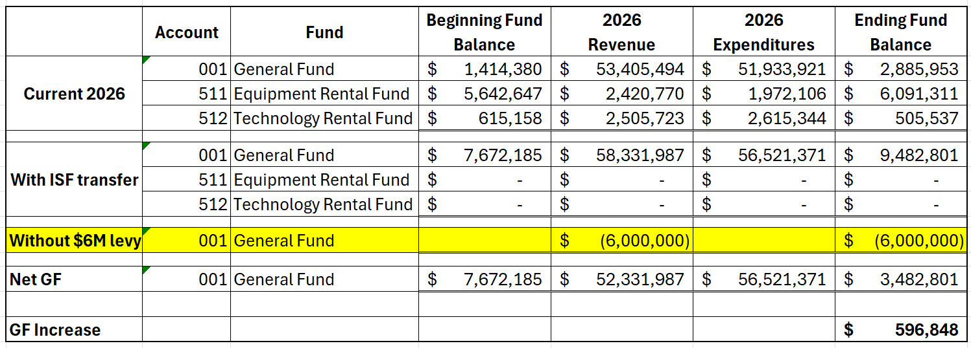
How the Numbers Work
Upon transfer, the beginning fund balance would transfer to the GF
Upon transfer, all future revenue sources would be deposited into the GF
Upon transfer, all future rental expenses would be paid from the GF
This results in a net benefit to the GF effectively utilizing an untapped resource
No city service reductions necessary

Slide 11
Alternative Budget (Equivalent level of services)
Reserve funds + ARPA + unbanked
($9.2M)
RFA annex. +
Levy Lid Lift
($12.4M)
Interfund Loan
($6.0M)
Single-year, Permanent Levy Lid Lift
($ 6.0M)
Approach used to balance the budget:
Reserve funds
($13.4M)
Adopted
Budgets
Forecast
Alternate budget plus $5M in new revenue
Unreserved funds
Adopted budget plus $5M in new revenue
General Fund Balance
$6M Levy Lid Lift
Fiscal emergency declared 11/6/23
GF Emergency Reserves (16%)
Rental Fund Transfer
Contingency Reserves (4%)
City Council’s adopted budget
Insolvent
2021 2022 2023 2024 2025 2026 2027 2028 2029

Slide 12
Alternative Budget Summary
A legal framework has been proposed to supplement the General Fund
It utilizes untapped financial resources sitting in the bank
It offsets proposed “cuts” if the $14.5M levy fails
It maintains a balanced budget without cuts
It provides time to right-size the levy for a future vote
The City Council would need to take legislative action to enact
Combined with the $5M in new revenue that the city is pursuing will provide for a robust budget – even a vibrant one!
This is a viable and transparent alternative to the current thinking that the citizens deserve to know and understand prior to the election

